Slide 1
Predicting Customer Conversion: Identifying High-Value Leads Through Data
Project 2 - Classification & Hypothesis Testing
Amanda Edwards
6/23/25

Slide 2
Contents / Agenda
Business Problem Overview and Solution Approach
Data Overview
EDA Results - Univariate and Multivariate
Data Preprocessing
Model Performance Summary
Conclusion and Recommendations

Slide 3
Business Problem Overview and Solution Approach
ExtraaLearn is an online educational start-up company desiring to identify:
Which leads are more likely to sign up and purchase the product (i.e. convert to paying customers)
What factors are most important in driving the lead conversion process
The profile of leads which are likely to convert to paying customers
To approach this problem, the following steps will be performed:
Become familiar with and explore the data
Perform univariate and bivariate analyses to understand individual variables and their distributions as well as correlation between independent variables and the target variable
Clean and prepare data, split data into training/testing sets
Perform classification modeling
Outcome variable is “status”, a binary variable indicating if customer converted or not
“0” is a customer that DID NOT convert to a paying customer
“1” for those that DID convert to a paying customer

Slide 4
Data Overview
Shape of the data set:
4612 observations/rows
15 columns/variables
Variable types:
Object (10 variables): ID, current_occupation, first_interaction, profile_completed, last_activity, print_media_type1, print_media_type2, digital_media, educational_channels, referral
Integer (4 variables): age, website_visits, time_spent_on_website, status
Float (1 variable): page_views_per_visit
There were no duplicate values or missing values (NA’s) in this dataset
Number of unique values for ID column: 4612 - this is the same number of observations in our data set, so each ID is unique

Slide 5
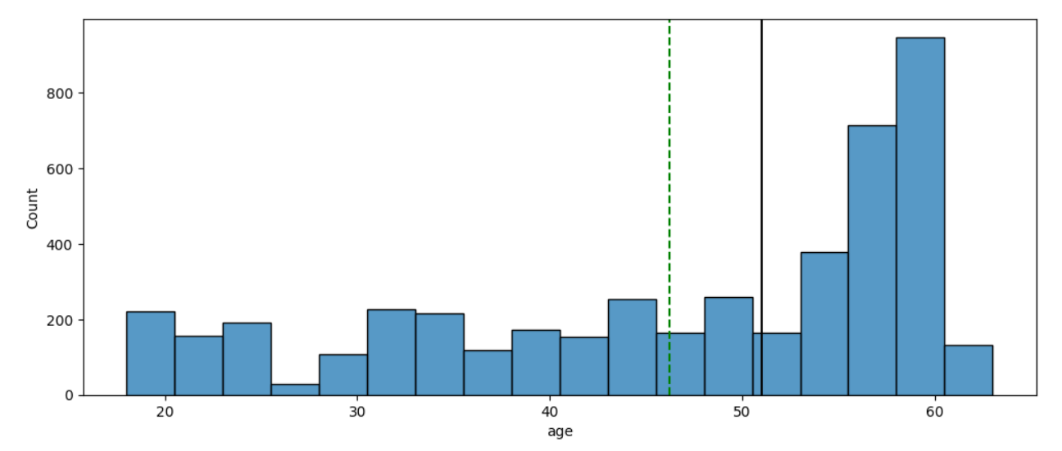
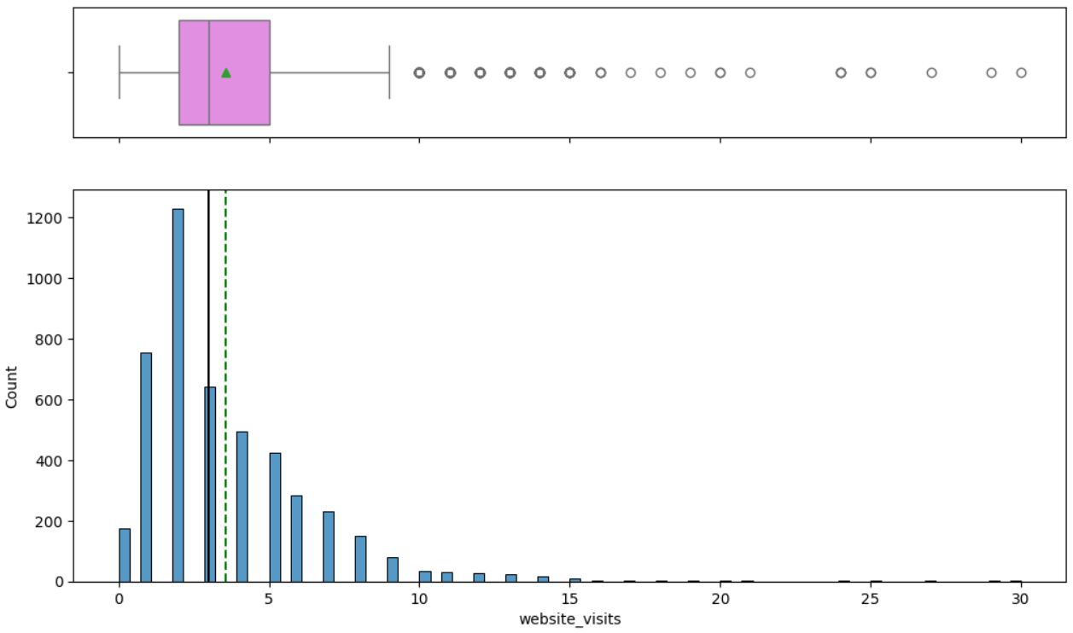
EDA Results - Numerical Variables
Age:
Range: 20–62; Median ≈ 51, Mean = 45
Left-skewed with more leads in 50s–60s
No outliers
Website Visits:
Range: 0-30; Median ≈ 3, Mean ≈ 3.5
Right-skewed with higher visit count of 2
Outliers present from 10-30
174 leads have not visited the website

Slide 6
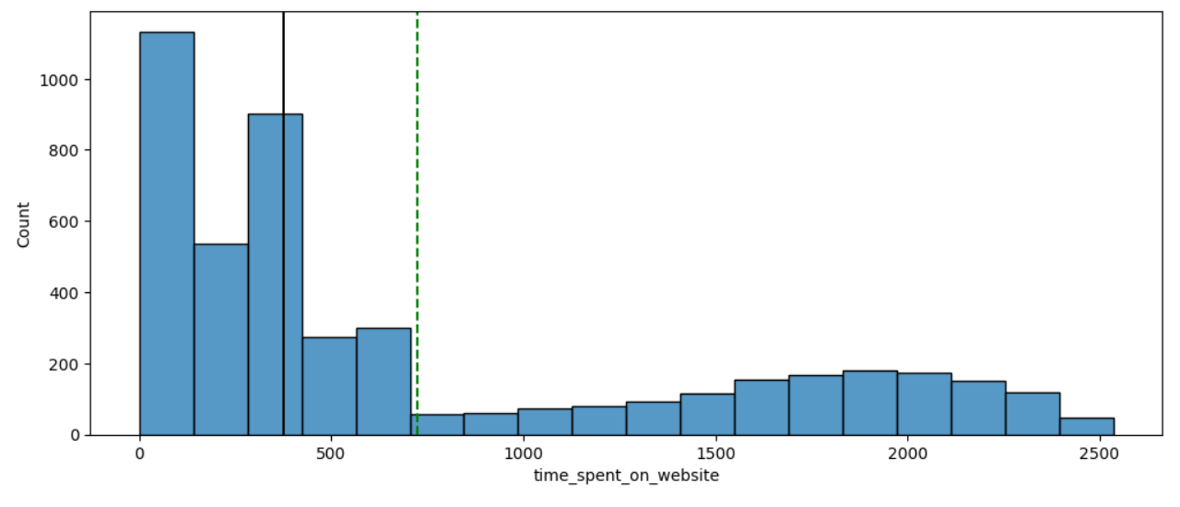
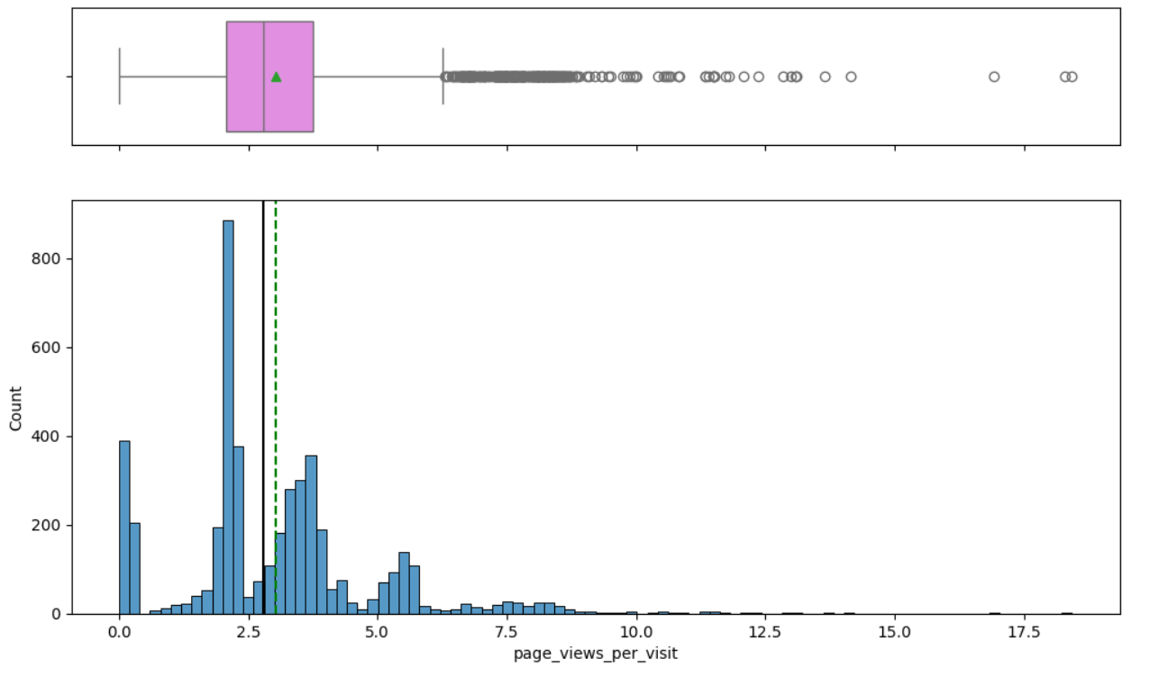
EDA Results - Numerical Variables
Time spent on website:
Range: 0- 2500
Mean(725) > median (400)
Skewed right, no outliers observed
Page views per visit:
Range: 0-18
Mean/median similar ≈ 2.75-3
Outliers extend from 6-18
Majority of data points clustered below 7.5 with the distribution resembling a right skew with several spikes and dips

Slide 7
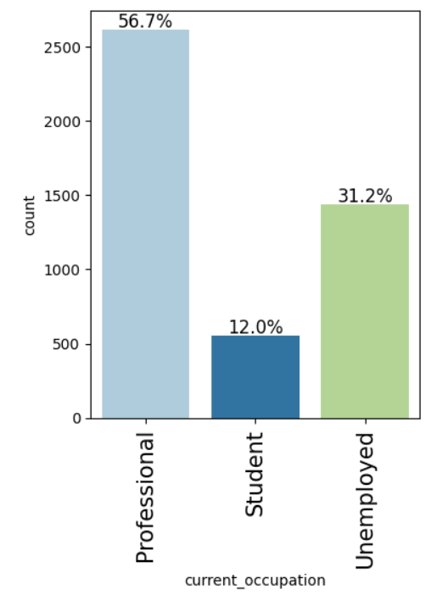
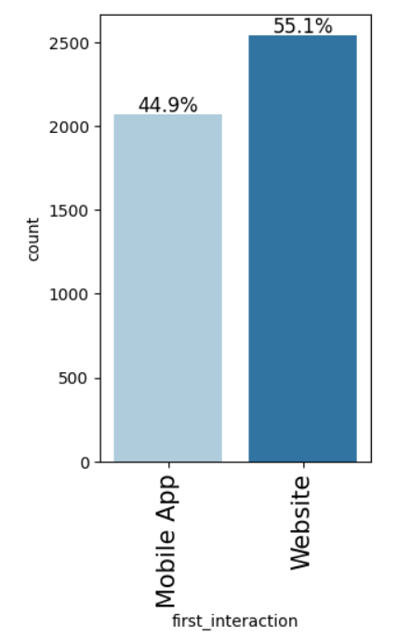
EDA Results - Categorical Variables
Current Occupation:
The majority (56.7%) are professionals - learn new skills
31.2% unemployed - potential career changers
First Interaction:
55.1% website
44.9% mobile app

Slide 8
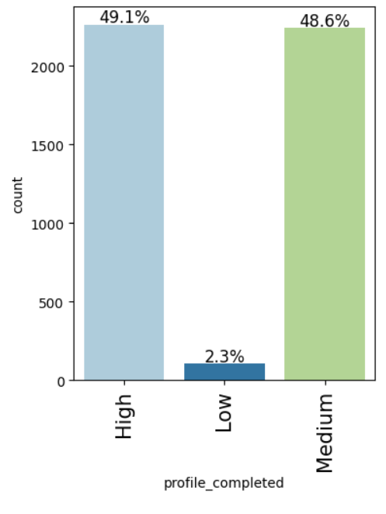
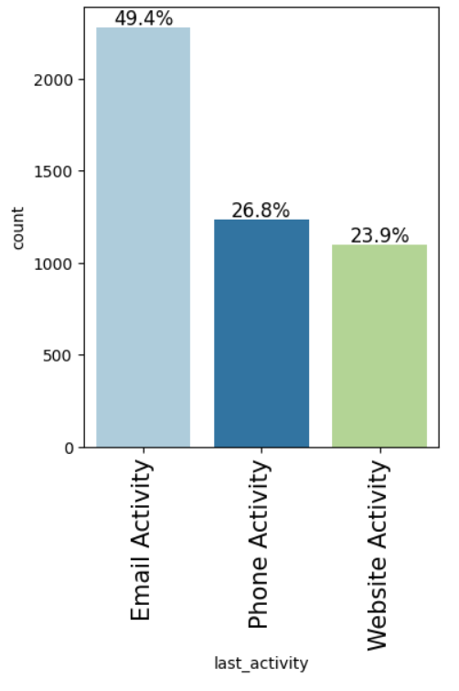
EDA Results - Categorical Variables
Profile Completed:
High and medium completion comprises nearly
all profiles, with only 2.3% in the low category
Last Activity:
The highest percent of activity is
email (49.4%) compared with roughly
25% for phone and website
Since most people engage with email,
the company needs to ensure this
form is readily accessible and quick
response is necessary

Slide 9
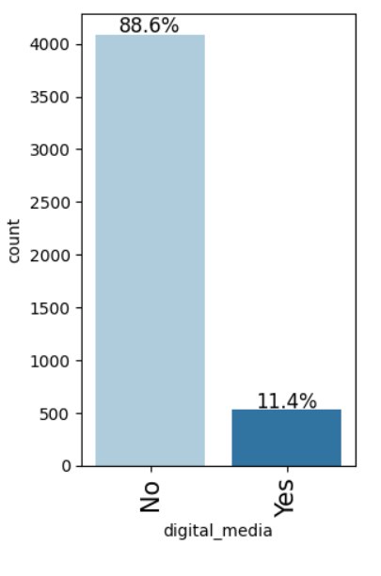
EDA Results - Categorical Variables
Print media type 1 (newspaper):
No 89.2
Yes 10.8% - seeing newspaper ads
Print media type 2(magazine):
No 94.9
Yes 5.1% seeing magazine ads
Digital media (graph shown):
No 88.6%
Yes 11.4% seeing digital media ads
More leads are seeing digital ads compared to other types of media, but most leads are not seeing ads.

Slide 10
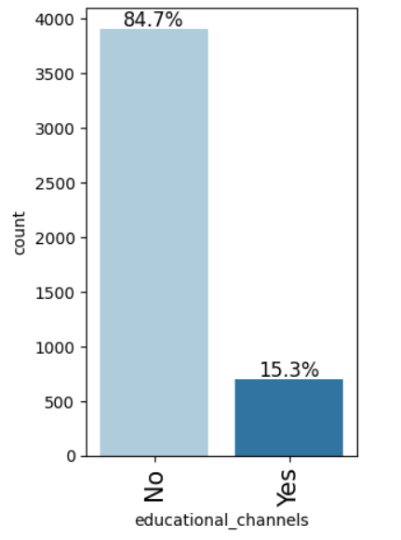
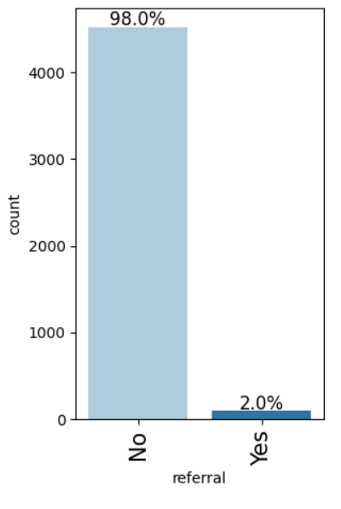
EDA Results
Educational channels:
Yes 15.3%
No 84.7%
More leads are hearing about our service through educational channels than other media or referrals
Referral:
Yes 2%
No 98%
Very low number of referrals to our service, this would be helpful to increase

Slide 11
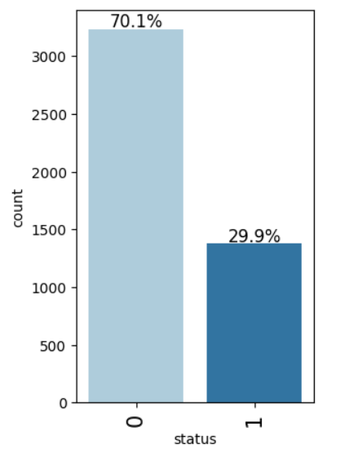
EDA Results - Dependent Variable “Status”
70.1% of leads did NOT convert into a paying customer
29.9% of leads DID convert into a customer
There is much room to increase lead conversion to paying customers

Slide 12
EDA Results - Univariate Key Observations
Approximately 30% of individuals are converting to paid customers
The majority of prospects are professionals followed by unemployed individuals
The average age of the prospects is 45 years
Only 2% of individuals are getting referred to the company
Regarding seeing advertisements the highest percentage (15.3%) are seeing them on educational channels and the lowest (5.1%) seeing ads from magazines
Approximately 50% of people reach out via email to inquire about the programs

Slide 13
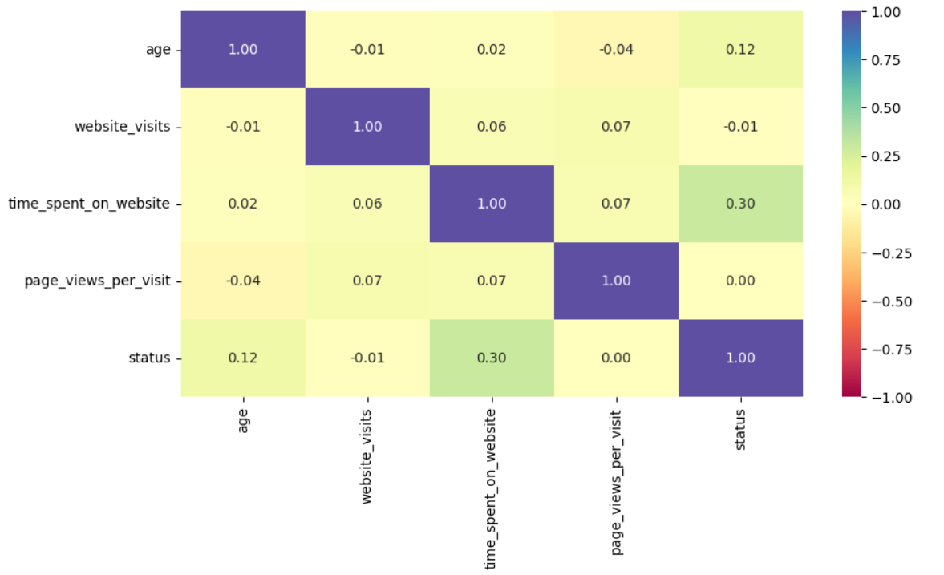
EDA Results - Bivariate Analysis
Correlation heatmap shows minimal correlation between variables
The highest correlation of 0.30 was between status and time spent on website
Indicates low multicollinearity or correlation between independent variables

Slide 14
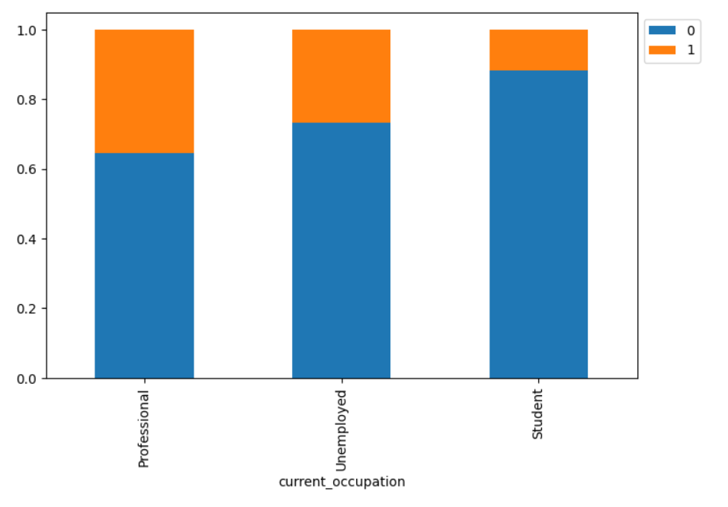
EDA Results - Bivariate Analysis
Greater proportion of professional prospects convert to paying customers, followed by unemployed individuals.
The lowest proportion of conversions
are within the student group.

Slide 15
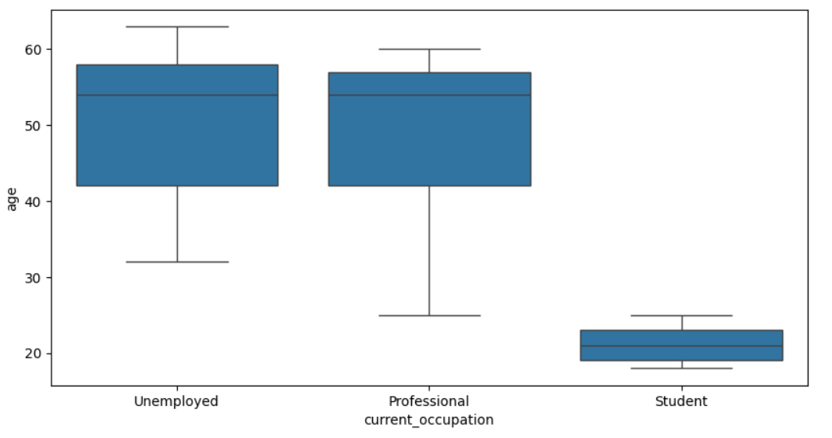
EDA Results - Bivariate Analysis
The boxplots show distribution of
age compared with occupational status
Age of unemployed versus professional
Prospects have similar profiles with
median age approximately 54 years,
though age range of professional is
larger and younger.
As one would expect, student age is
much lower with median of 22 years

Slide 16
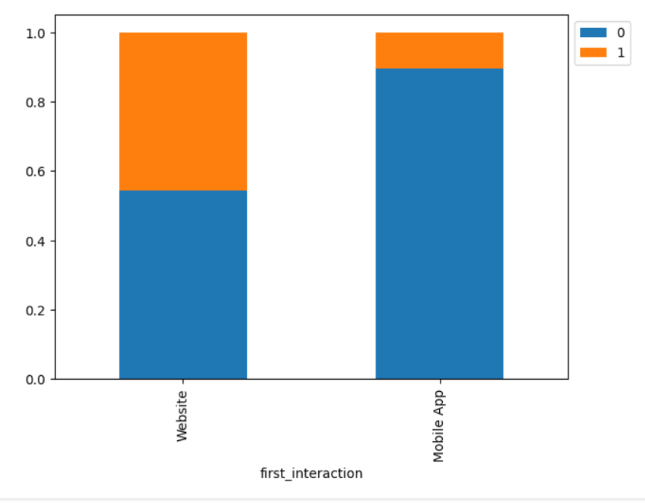
EDA Results - Bivariate Analysis
This shows people who
visit the website as their first
interaction have a higher
proportion of conversions to paying
customers compared to if their first
interaction is on the mobile app
45% conversions with website as
first interaction
10% conversions with mobile app
as first interaction

Slide 17
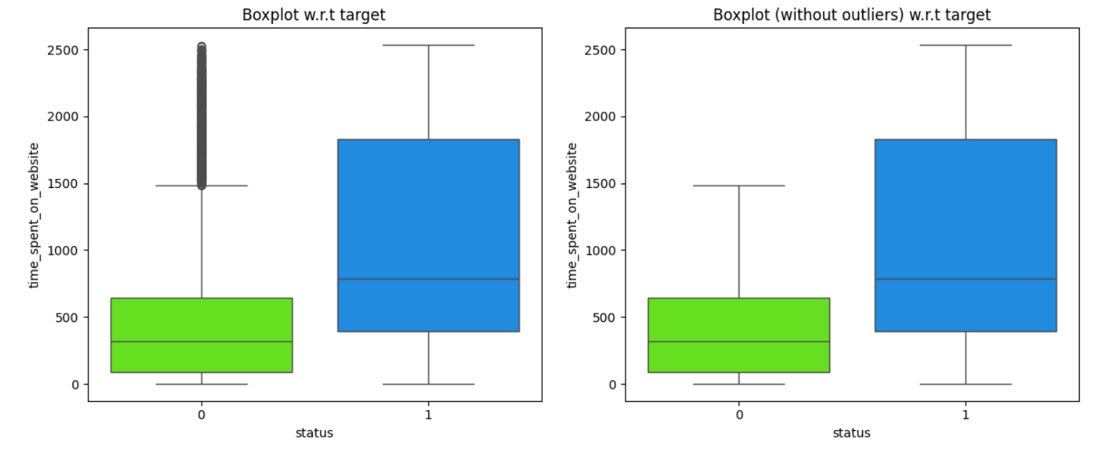
EDA Results - Bivariate Analysis
Comparing time spent on the website between groups:
Converted prospective customers median time = 789
Not converted prospective customers median time = 317
Many outliers present
This shows that people who became paying customers spent much more time on the website

Slide 18
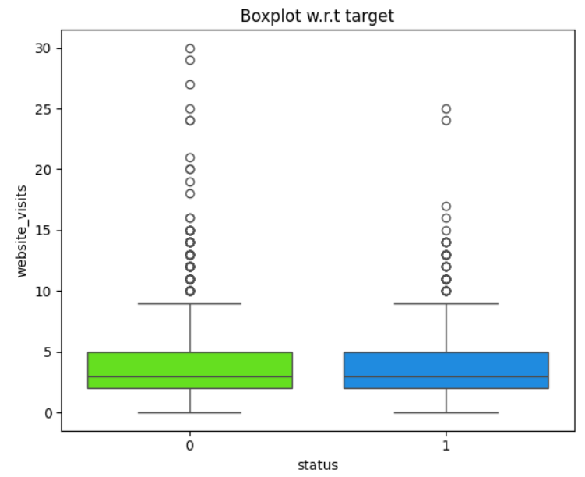
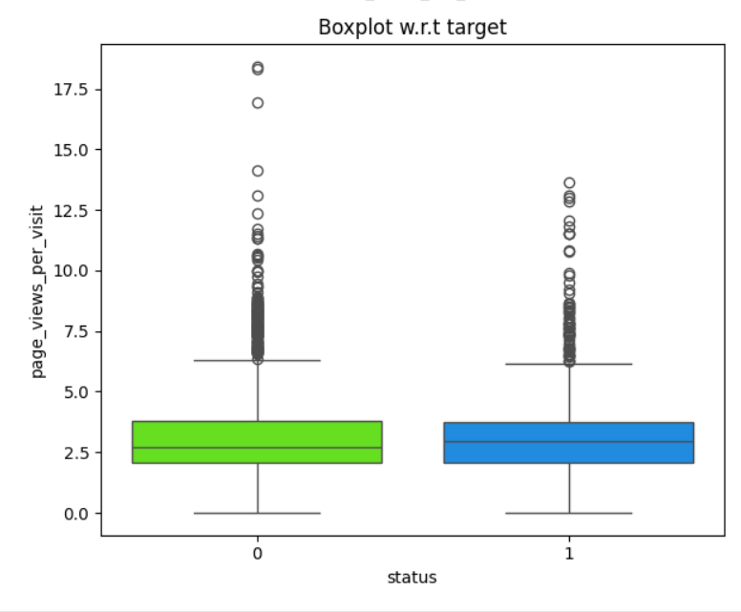
EDA Results - Bivariate Analysis
Conversely to amount of time spent on the website, plotting website visits and page views per visit yields similar results between groups
This shows that both groups of customers (paying converted, non-paying) have similar characteristics in number of website visits and page views, but people who end up converting to paying customers spend much more time navigating the website

Slide 19
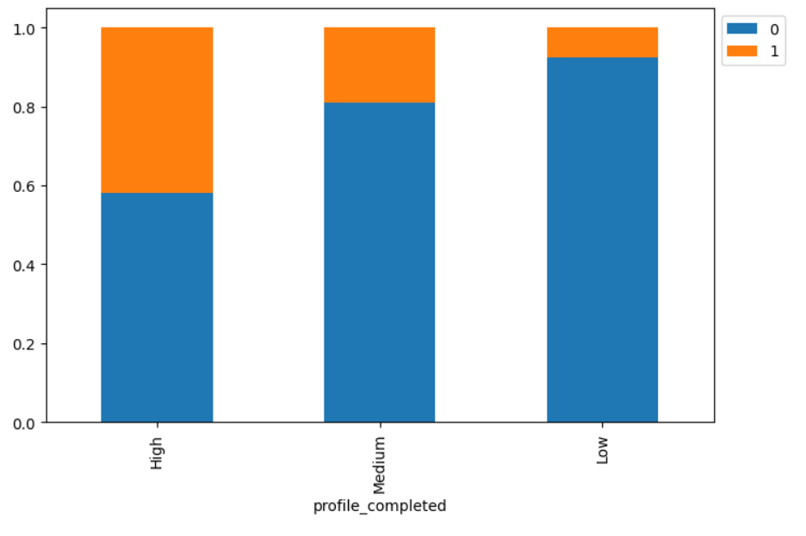
EDA Results - Bivariate Analysis
The accompanying barplot shows level of profile completion has an impact on lead status:
Higher profile completion linked to higher proportion of paying customers (~42%)
Medium completion leads to approximately 20% of leads converting
Lower profile completion linked to smaller proportion of paying customers (<10%)
Analysis between last activity and status:
Website activity has a higher conversion
rate compared to email and phone
Advertisement medium and status:
Similar between group of approximately 30%
conversion across all groups of digital,
educational, Newspaper, and magazine ads

Slide 20
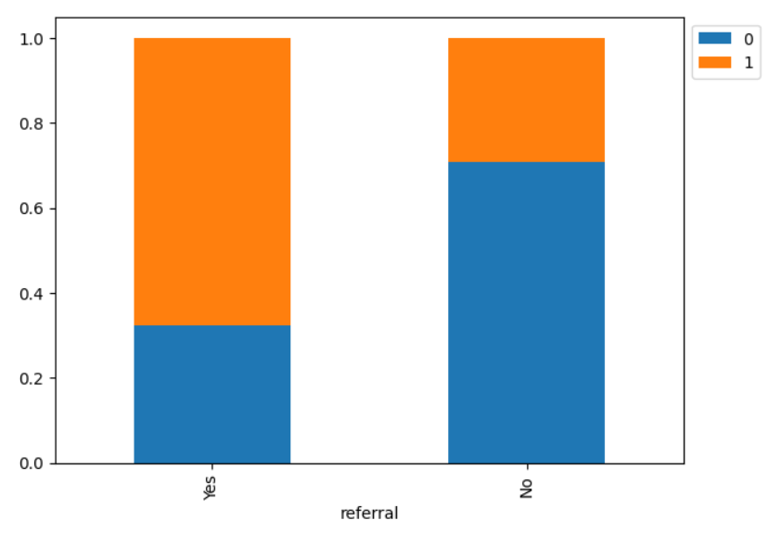
EDA Results - Bivariate Analysis
This graph shows proportion of people who were referred to ExtraaLearn or not and the impact on status
Individuals who had a referral were more likely to convert to a paying customer
65% converted if they had referral
30% converted without a referral
Recall that univariate analysis revealed that only
2% of people were referred however the
majority of them became paying
customers - it may increase our paying
customers if we can increase referrals

Slide 21
Data Preprocessing
Outlier check of numeric variables:
No outliers in age or time spent on website
Outliers present in website visits and page views, however the values do not seem out of the ordinary or entered incorrectly and therefore were not be replaced or removed
Created Y with the variable “status”
Created X with the remaining variables and created dummies for the categorical variables
Split the data into training/testing sets at 70/30 ratio
3228 observations in training set
1384 observations in testing set

Slide 22
Model Building
Built and ran the following models:
Decision Tree
Decision Tree with hyperparameter tuning
Random Forest
Random Forest with hyperparameter tuning

Slide 23
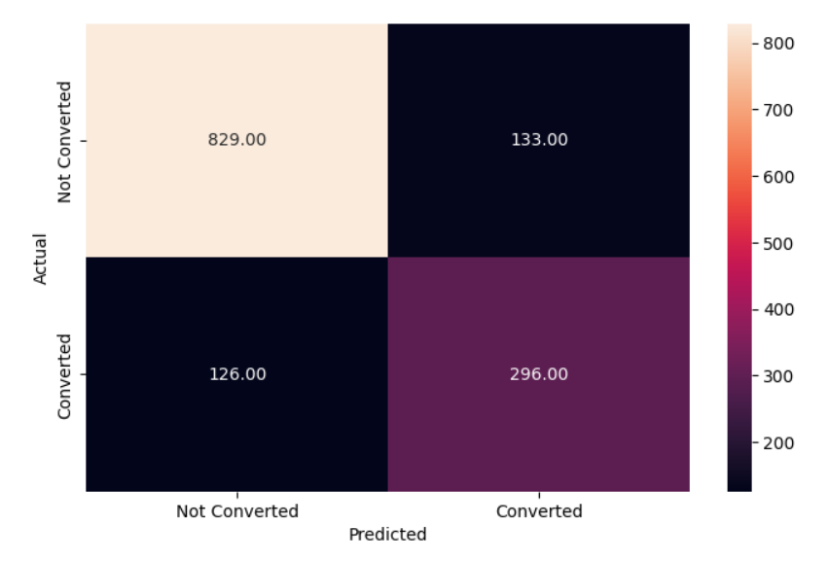
Decision Tree (DT) Results
Training data - Decision Tree confusion matrix:
Accuracy = 1.00
Precision = 1.00
Recall = 1.00
Decision tree is overfitting the
training set and will not be
useful in predicting testing data
Testing data - Decision Tree confusion matrix (shown here):
Accuracy = 0.81
Precision
Group 0 = 0.87, Group 1 = 0.69
Recall
Group 0 = 0.86, Group 1 = 0.70
Model not fitting the testing data well - more accurate predicting group 0

Slide 24
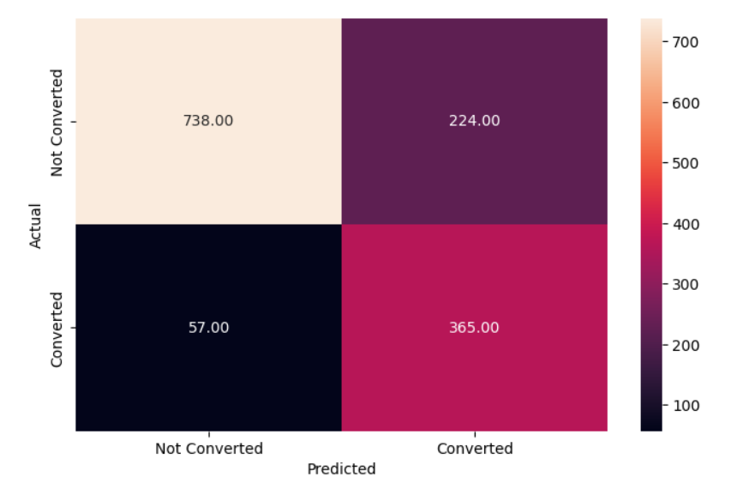
Decision Tree Results - After Hyperparameter Tuning
Training data - DT confusion matrix:
Accuracy = 0.80
Precision:
Group 0 = 0.94, Group 1 =0.62
Recall
Group 0 = 0.77, Group 1 = 0.88
Much better than prior model - not overfitting
Testing data - DT confusion matrix (shown):
Accuracy = 0.80
Precision:
Group 0 = 0.93, Group 1 = 0.62
Recall:
Group 0 = 0.77, Group 1 = 0.86
Tuning the model resulted in reduced overfitting
Good at predicting those who will not convert (93% of the time) - few false positives
Model correctly identified those who will convert 86% of the time

Slide 25
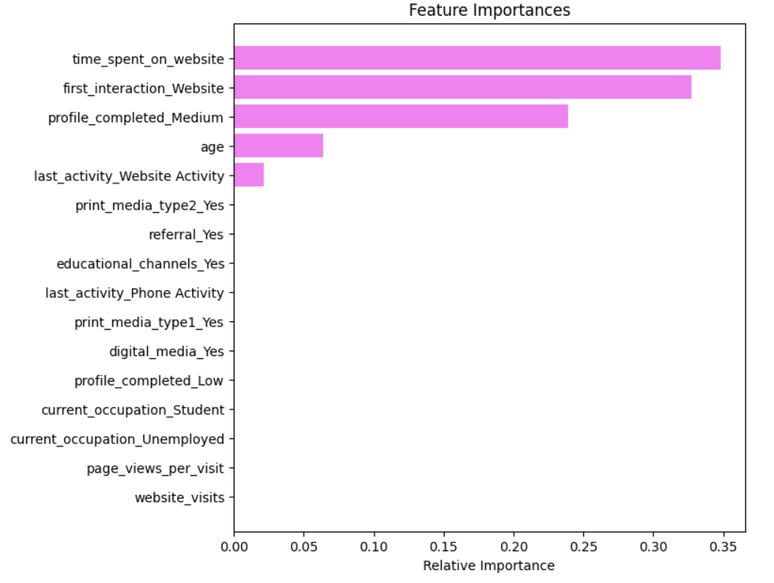
Decision Tree Tuned - Feature Importance
Most important features of tuned decision tree (top 3):
Time spent on website - 34.8 % of total information gain - most important predictor in becoming a paid customer!
First interaction website - 32.7% of total information gain
Profile completed medium - 23.9% of total information gain

Slide 26
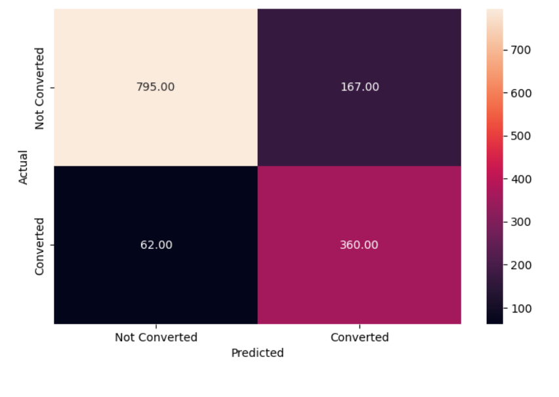
Random Forest (RF) & Random Forest Tuned Results
Random Forest:
Overfitted model - not ideal for predicting test data
Random Forest Tuned (Confusion matrix shown):
Training data:
Accuracy = 0.84
Precision: group 0 = 0.94, group 1= 0.68
Recall: group 0 = 0.83, group 1 = 0.87
Test data results:
Accuracy = 0.83
Precision: group 0 = 0.93, group 1= 0.68
Recall: group 0 = 0.83, group 1 = 0.85

Slide 27
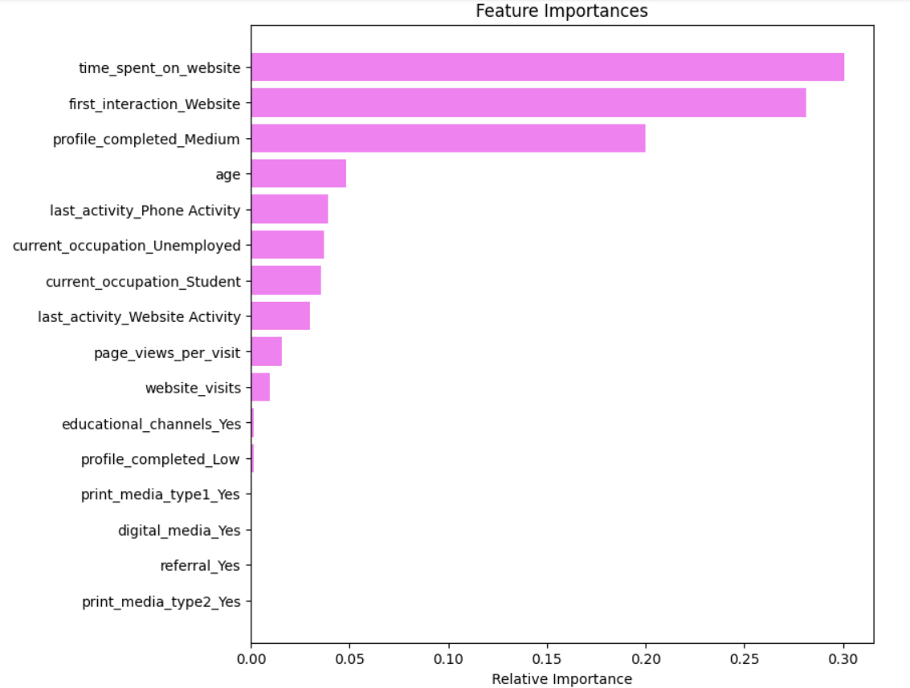
Random Forest Tuned - Important Features
Top 5 important features:
Time spent on website (30%)
First interaction website (28%)
Profile completed medium (21%)
Age (5%)
Last activity phone activity (4%)
Similar to the important featured identified with the decision tree model. Time spent on website was the most important factor followed closely by first interaction website. These variables provide the most information in predicting the status outcome.

Slide 28
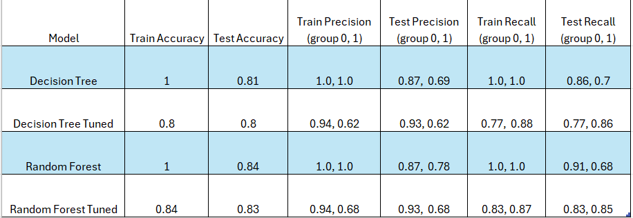
Model Performance Summary Table

Slide 29
Which Model Performed Best?
Best model = Random Forest Tuned model
Reasoning:
Decision Tree and Random Forest models both overfit the training data and therefore were not ideal to predict testing data
Our goal is to maximize recall (i.e. identifying false negatives, or a lead that would have converted, but the model predicted they would not ). The RF tuned model had the best overall recall for both training and testing data in determining placement into group 0 or group 1
Though accuracy is not the best measure due to imbalanced data in group 0 versus group 1, accuracy is higher in the Random Forest tuned model compared to Decision Tree tuned model

Slide 30
Conclusions & Recommendations
Profile of a lead more likely to convert to a paying customer:
Leads who visit the website as their first interaction and spend significant time navigating the website
Professionals or unemployed individuals, in their 40’s and 50’s
Leads who have medium to high profile completion

Slide 31
Conclusions & Recommendations
The most important factor in determining whether a lead will convert is the amount of time spent on the website, followed by first interaction being via website. This exemplifies the importance of:
Ensuring the website is user friendly, up-to-date, engaging, and informative
Evaluating the mobile app to improve the ease of use or appeal of our programs. This may help to increase the proportion of people accessing our website via mobile app to convert to paid customers
Allocating resources to identify these individuals early
Potentially provide additional incentive to sign up such as a free one-week trial
Profile completion of ‘medium’, age, and last activity phone activity were also important predictors of converting to paying customers
Target leads age 40’s and 50’s as they are more likely to become customers
Encourage leads with partial profile completions to complete their profiles, as it may tip them into converting
Identify if there are consistent challenges to completing profiles
The variable ‘referral’ did not appear as an important factor potentially because of the small number of leads who were referred, however of the 2% of people that had a referral, 65% converted to a paying customer. This may be an area to gain leads and conversions. Offering incentives or additional programs for referring others to our company.

Slide 32
APPENDIX

